Slide 1
Electrical Measurements ─ Meters

Slide 2
Introduction to Meters
Analog meter
  Uses a graduated scale with a pointer
  Provides better graphic display of rapid changes in current/voltage
Digital meter
  Provides a reading in numbers
  More accurate than analog meters

Slide 3
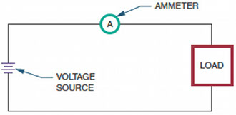
Types of Meters
Figure 6-5. The placement of an ammeter in a circuit.

Slide 4
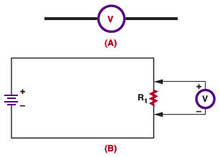
Types of Meters (cont’d.)
Figure 6-6. (A) Schematic symbol for a voltmeter.
(B) A voltmeter is connected in parallel in a circuit.

Slide 5
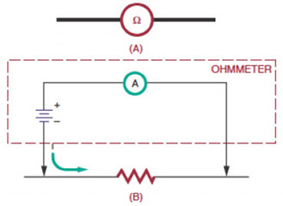
Types of Meters (cont’d.)
Figure 6-7. (A) Schematic symbol for an ohmmeter. (B) An ohmmeter applies
a voltage across the component being measured and monitors the current
flowing through it.

Slide 6
Multimeters
Multimeter
  Combines a voltmeter, ammeter, and ohmmeter into one package
VOM (volt-ohm-milliammeter)
  An analog multimeter that measures volts, ohms, and milliamperes
DMM
  A digital multimeter

Slide 7
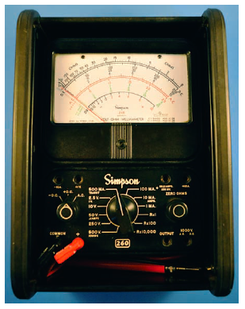
5 Voltage positions
4 current positions &
3 resistance positions
Function switch
+DC, -DC, AC
Figure 6-8. An analog multimeter.

Slide 8
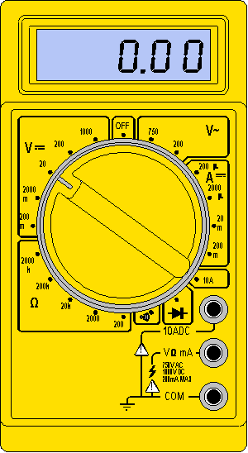
DMM

Slide 9
Multimeters (cont’d.)
Disadvantages of a DMM:
  Requirement for batteries or other source of electricity
  Voltage limitation; if exceeded could damage the meter.
  Inability to measure an instantaneous change in a signal faster than the sampling time

Slide 10

Measuring Current
Figure 6-9. An ammeter is connected in series to a circuit.
Red: +
Black: -
Connect - To - & + to +
Pointer from left to right.
Reverse leads if needle moves in opp. direction

Slide 11
Measuring Current (cont’d.)
Caution:
  Always turn off power before connecting an ammeter to a circuit
  An analog ammeter must never be connected in parallel with any ckt component (s/c; fuse will blow & damage to meter)
  Never connect an ammeter directly to a voltage source (s/c)
  Internal resis of Ammeter adds to ckt resis. So measured current reduces.

Slide 12
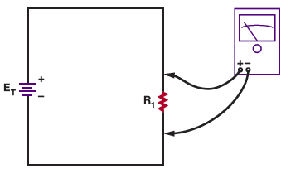
Measuring Voltage
Figure 6-13. When connecting a voltmeter into a circuit, be sure to observe polarity.

Slide 13
Polarity is imp. Connect + to +. Reverse the leads if pointer goes from right to left.

Slide 14
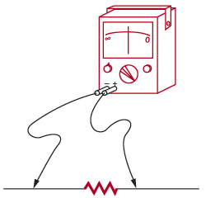
Measuring Resistance
Figure 6-14. When using an ohmmeter to measure resistance, the component being measured must be removed from the circuit.

Slide 15
Measuring Resistance (cont’d.)
Continuity test (or check)
  Determines if current path is continuous
  Open circuit
    Indicates high resistance
  Short circuit
    Zero ohms of resistance
  Closed circuit
    Indicates low resistance

Slide 16
Advantages of DMM:
higher accuracy
Digital readout
Repeatability of reading
Uses very little current to test resis.
uses audio signal for continuity test

Slide 17
Reading Meter Scales
Full scale value
  Maximum value indicated by a meter
Ammeters and voltmeters
  Read from left to right
  Linear scales
Ohmmeters
  Read from right to left
  Nonlinear scales

